Slide 1

Final Project Segment 2
Group 7

Slide 2
Presentation
Selected Topics
Data Sources
​Data exploration
Data Analysis
Dashboard

Slide 3
Ambulance Patient Offload Times
Analysis of the Ambulance Patient Offload Times (APOT) in Sacramento County. The goal of this project is to identify what is influencing the extended wait times. Shedding a light on where the problems are will show the parties involved where to look and help initiate a plan to alleviate the current situation. The questions we hope to answer are:
Which impressions has the longest/shortest APOTs? (Overall and by Hospital codes)
Compare impressions to zip codes. Which zip codes have the highest/lowest rates of which impressions?
Which zip codes utilize ambulance transports to the ER the most in 2017-2022?
Wait times per hospital by date/time
Do any patterns arise from the data?

Slide 4
Data Sources
The data selected for this project was obtained from Sacramento County Emergency Medical Services Agency. The data set includes the following data points :
Destination Hospital identifier
Destination Hospital location Latitude and Longitude
Date/Time of Occurrence
Ambulance Patient Offload Time (APOT)
Patient Complaint identifier
Ambulance Agency Identifier
Ambulance Unit identifier
Postal Code of Where call was Originated

Slide 5



Data Exploration
stratification
Scikit Learn
Training Sets
Through machine learning it was found that there is a strong relationship between APOT and hospital codes. To further explore the data and understand this relationship data is being separated into subgroups of individual hospitals as part of the stratification process.
Linear Regression
Balanced Random Forest Classifier
Easy Ensemble AdaBoost Classifier
Oversampling
SMOTE Oversampling
Under sampling
Combination (Over and Under) Sampling
Synergize scalable e-commerce

Slide 6

Data Analysis

Slide 7
Process

Slide 8
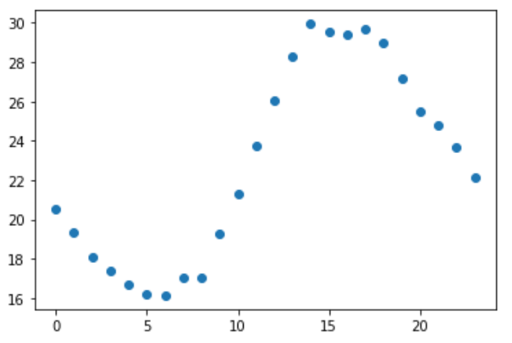
Template Outline
Ambulance Patient Offload Times
Ranking (Random Forest)
Confusion Matrix
APOT Average per Hour
Importance of Features | Featured
Predicted

